Slide 2
Ansible CI/CD Lab
Testing Ansible and Tower with Ansible and other things

Slide 3
Presenters
Who’s in front of you?
Joe Pisciotta, Cloud and Devops Senior Consultant in the NE
Specializes in Infrastructure, Cloud Management and Automation, as well as DevOps, Infrastructure Management, and OpenShift
Patrick Carney, Senior Consulting Engineer with Open Innovation Labs
Specializes in CI/CD, DevOps, Automation, Integration and Container Development on OpenShift

Slide 4
What is CI/CD
Continuous Integration basically just means that the developer's working copies are synchronized with a shared mainline several times a day.
Continuous Delivery is described as the logical evolution of continuous integration: Always be able to put a product into production.
Continuous Deployment is described as the logical next step after continuous delivery: Automatically deploy the product into production whenever it passes QA.

Slide 5

What/Who is Jenkins
Jenkins® is an open source automation server
(The butler formerly known as Hudson)
With Jenkins, organizations can accelerate the software development process by automating it. Jenkins manages and controls software delivery processes throughout the entire lifecycle, including build, document, test, package, stage, deployment, static code analysis and much more.

Slide 6
What does CI/CD look like

Slide 7
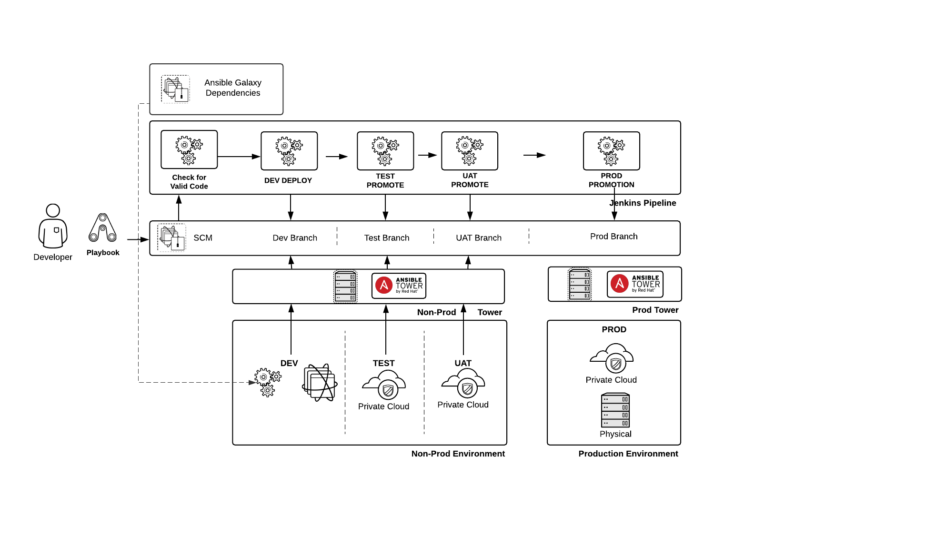

Slide 8
Ansible Playbook and Role CI/CD
Automation is code and should be treated as such
Develop
Version
Test
Review
Deploy
Deployment of Ansible automation in an automated manner
Accept into initial Lifecycle Environment
Deploy into initial Lifecycle Environment
If all is okay then request promotion into next Environment until Prod
Code is accepted into production
Code is then deployed automatically
Notes:
The main goal of this “hackathon” is to develop best practices for creating CI/CD pipelines for Ansible Playbooks and Roles.
Automation is code and should be treated as such. This means that aside from storing the code in a central repository, it should also be tested and reviewed.
Automation should also be deployed through a process. This includes having the automation run automatically once it is approved and has been through testing.
At typical customers, they will have multiple lifecycle environments before the automation should be deployed to production.

Slide 9
Why use CI/CD for Ansible Playbooks
Ensures automation code has been validated before deployment
Enforces deployment processes
Quicker and more reliable development of Ansible code
Decrease code review time
Test code deployment in the same manner as the production deployment
Notes:
Ensures automation code has been through syntax validation and any number of other validations of the Ansible code
Enforcing deployment processes makes it less likely to have people deploy code in a non-standardized ad-hoc method that can cause issues of their own
The method for deploying code in the same manner decreases possibility of environmental factors causing errors

Slide 10
Ansible Tower
Common Ansible Tower Deployment Techniques
Jenkins Tower Plugin
Tower API
Tower CLI
Ansible Playbook Calling the Tower Management Modules
Create Projects, Job Templates, Inventories from GIT source
Run Jobs in Tower or set Schedule on Job Template
Notes:
Ansible Tower is a central piece to many customer’s deployment for ansible automation
It is easy to incorporate this into Jenkins using the Ansible Tower Plugin - prior to this plugin you would be able to use the Ansible Tower API
Running directly in Tower allows for deployment to be fully tested - not just from the ansible playbook command

Slide 11
What do we want to reach?
Give you the chance to try things out!
We’ve prepared examples of implementations for you to try out
Feed in your own experience and opinions on implementation
Design your own “Best Practices” architecture diagram (on posterboard or lucidchart)
Improve the existing examples
Start the discussion about best practices in CI/CD
Have a central Git repo to keep and maintain reference implementations, also after the RHTE
Notes:
If using posterboard make sure to take a picture

Slide 12


Ideas/Tech to Look at...
Ansible Tower Plugin
https://wiki.jenkins.io/display/JENKINS/Ansible+Tower+Plugin
https://plugins.jenkins.io/ansible-tower
Ansible Tower Team Module
https://docs.ansible.com/ansible/latest/modules/tower_team_module.html
Molecule
https://molecule.readthedocs.io/en/latest/

Slide 13
In Short
Instructions under https://github.com/redhat-cop/automate-cicd
→ hackathons → rhte-2018-amer
http://bit.ly/rhte-guidgrabber
Lab Code: A1014
GuidGrabber activation key: cicd
bastion user: lab-user
Password: r3dh4t1!
Automation CoP @ https://red.ht/autocop

Slide 14
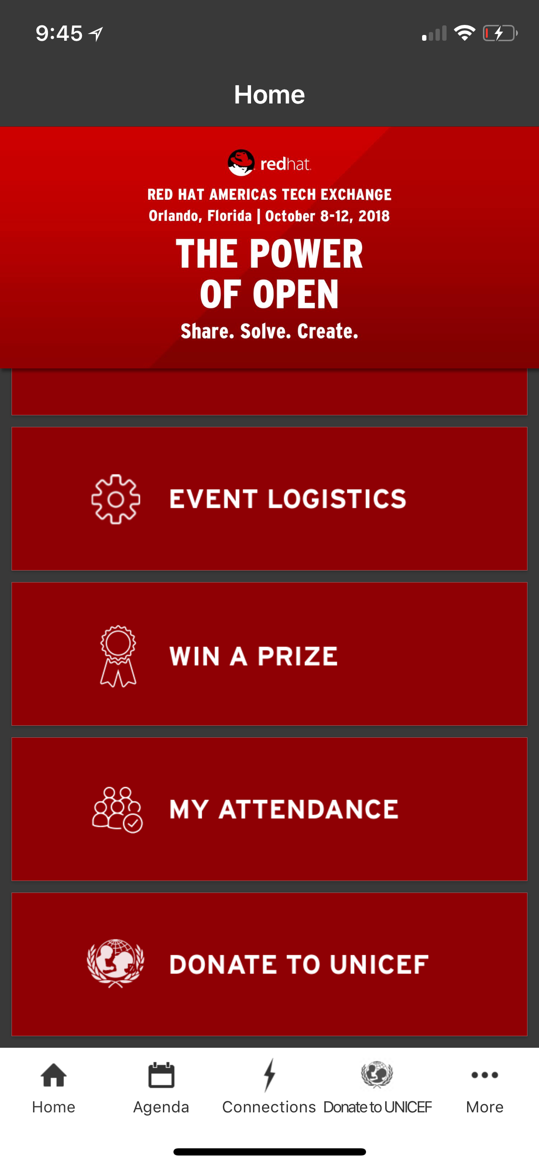
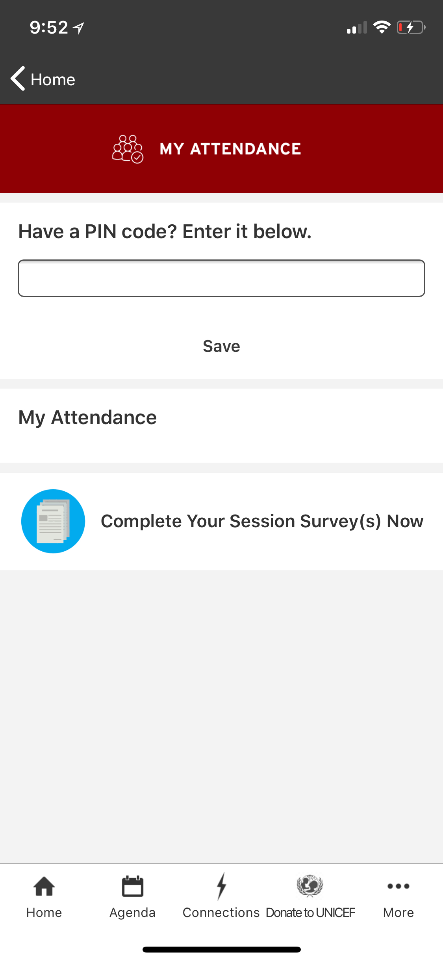

Session 1:
Tuesday @ 1:00pm
Get Credit for This Session!
In the mobile app, go to the MY ATTENDANCE page
On this page, please enter the below PIN code in the designated box DLGCK
Tap Save to submit your PIN
Open/Review the My Attendance list
Select Complete your Session Survey(s) Now
2.
3.
4.
5.
1.

Slide 16
Proceeding
Point your browser at https://github.com/redhat-cop/automate-cicd/tree/master/hackathons/rhte-2018-amer (or https://github.com/redhat-cop/automate-cicd → hackathons → rhte-2018-emea).
Read the instructions, try out, fork and create pull requests…
The password is ALWAYS: r3dh4t1!
At the end we’ll have a short discussion to summarize your learnings and deeds
After the RHTE, the https://github.com/redhat-cop/automate-cicd repo will remain
with your help and input
under the custody of the Automation CoP https://red.ht/autocop

Slide 17
Context
Why are we here?
Ansible / Automation is “Infrastructure as Code”
IF Infrastructure is Code THEN we should treat it like code!
Write it
Version it (Git)
Review it
Test it ⇒ automatically aka Continuous Integration, that’s today’s topic!
Deploy it ⇒ automatically aka Continuous Deployment

